Slide 1

Note: The data and information in this document is reflective of a hypothetical situation and client. This document is to be used for KPMG Virtual Internship purposes only.
Sprocket Central Pty Ltd
Data analytics approach
[Division Name] - [Engagement Manager], [Senior Consultant], [Junior Consultant]

Slide 2
Note: The data and information in this document is reflective of a hypothetical situation and client. This document is to be used for KPMG Virtual Internship purposes only.
Agenda
Introduction
Data Exploration
Model Development
Interpretation

Slide 3
Note: The data and information in this document is reflective of a hypothetical situation and client. This document is to be used for KPMG Virtual Internship purposes only.
Introduction
Key attributes of target customers to consider:
Age Group
Job Industry Category
Wealth Segment
State

Slide 4
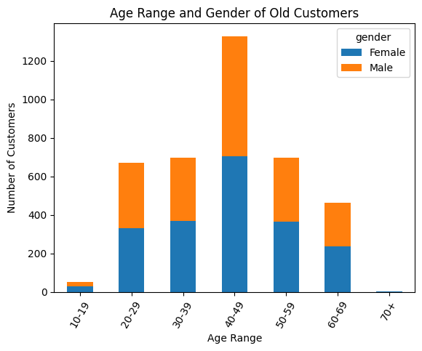
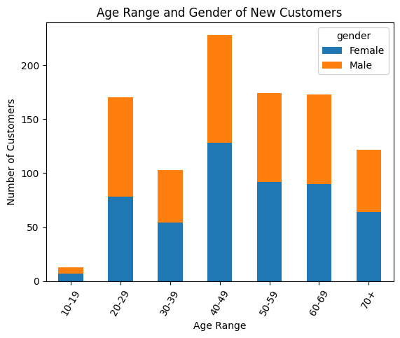
Note: The data and information in this document is reflective of a hypothetical situation and client. This document is to be used for KPMG Virtual Internship purposes only.
Data Exploration - Age Group
Based on data of old customers, products were most popular among
40 – 49 year olds
Slightly more popular among females than males
Based on data of new customers,
Still popular among females and 40 – 49 year olds
Increasing popularity among the older generation
Declining popularity among 30 – 39 year olds

Slide 5
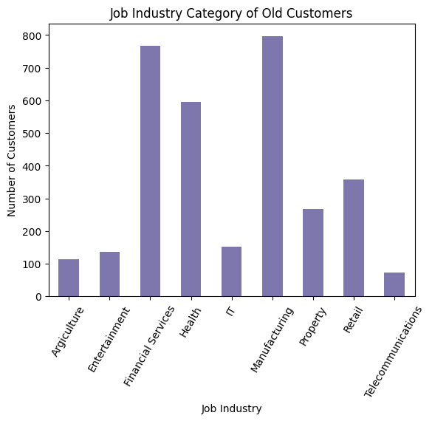
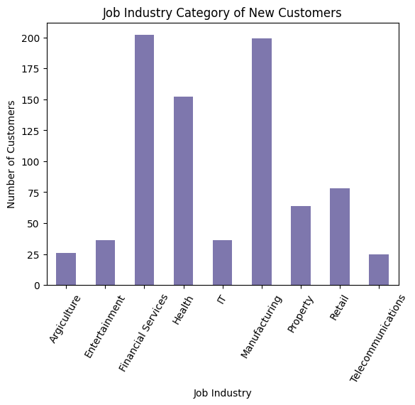
Note: The data and information in this document is reflective of a hypothetical situation and client. This document is to be used for KPMG Virtual Internship purposes only.
Data Exploration – Job Industry Category
Based on data of old customers, products were most popular among those working in
Manufacturing
Financial Services
Health
Lucrative pay in these sectors → afford luxury goods
Based on data of new customers, minimal changes

Slide 6
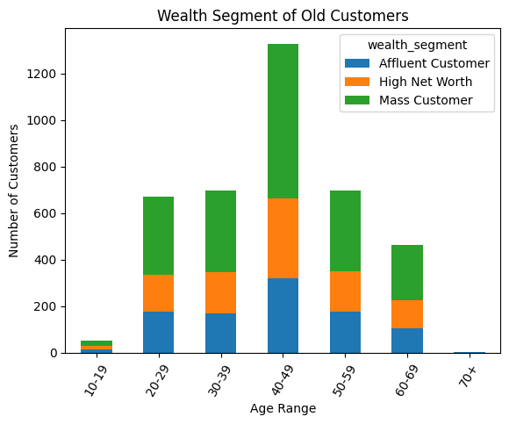
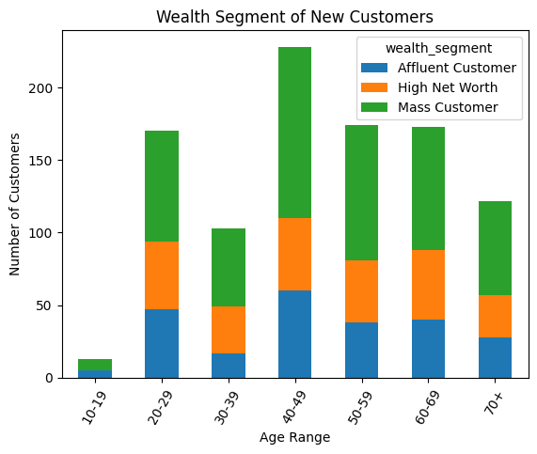
Note: The data and information in this document is reflective of a hypothetical situation and client. This document is to be used for KPMG Virtual Internship purposes only.
Data Exploration – Wealth Segment
Based on data of old customers, ranking of popularity of products among social classes
Mass Customer
High Net Worth
Affluent Customer
Based on data of new customers, slightly more popular among high net worth and affluent customers compared to previous data

Slide 7
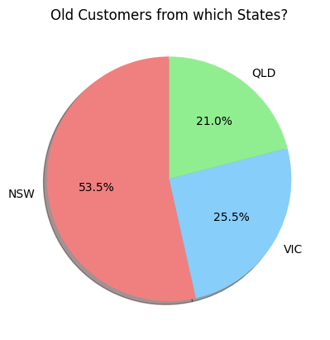
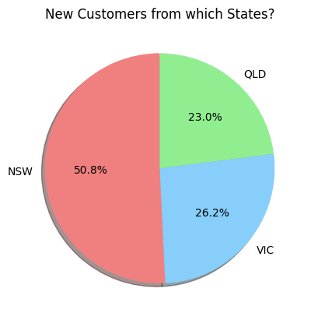
Note: The data and information in this document is reflective of a hypothetical situation and client. This document is to be used for KPMG Virtual Internship purposes only.
Data Exploration – State
Based on data of old customers, products most popular in New South Wales
Based on data of new customers, slightly more popular in Queensland and Victoria as compared to previous data, but minimal changes overall

Slide 8
Note: The data and information in this document is reflective of a hypothetical situation and client. This document is to be used for KPMG Virtual Internship purposes only.
Model Development
Multiple linear regression model to predict how many bikes new customers will buy:
Features: age, gender, job industry, wealth status, state living in, etc.
Data used to predict: number of bikes bought in the past 3 years
Predicted value: likelihood of buying new bike
The results of this model will predict which new customers are most likely to be loyal and high-value, so that the company can specifically target them.

Slide 9
Note: The data and information in this document is reflective of a hypothetical situation and client. This document is to be used for KPMG Virtual Internship purposes only.
Interpretation
High-value customer group to retain:
40 – 49 years old
Working in financial, manufacturing and health sectors
Mass customers
From New South Wales
Based on data of new customers, there is potential to capture the older generation and more affluent customers by marketing the products to suit their taste

Slide 10
Note: The data and information in this document is reflective of a hypothetical situation and client. This document is to be used for KPMG Virtual Internship purposes only.
Thank You!

